Slide 1

17) ESCCCP24 2025-2026 2 July 2026

Slide 2
Check-in
Thu 2 July 2026

Slide 3
Using Plus Int Letter of Enquiry.pptx, we
learnt how to write a letter asking for information, and
ask indirect questions.
Using English Grammar In Use Unit 46 Have Something Done.pptx slides 1-9, we
practiced have/get something done.
Homework
indirect questions Ex 3. Write as an email rather than a letter. The email address is: weselltravelbags.co.uk.
See the next slide.

Slide 4
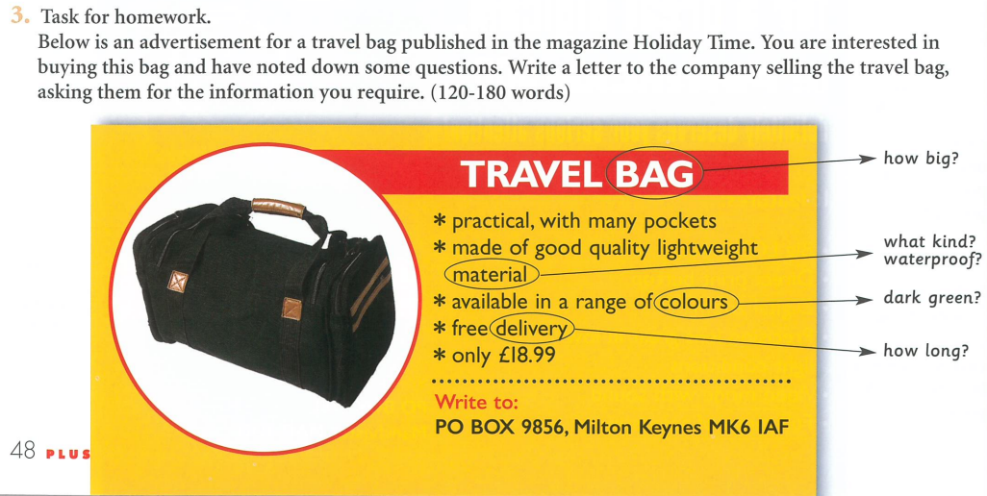
Email: weselltravelbags.co.uk
For further information.

Slide 5
Reading & Writing
17:45 – 20:45

Slide 6
2025 Reading Booklet July 25.pdf

Slide 7
13 B (Padel) – “there are hopes that the sport might one day be included in the Olympics.”
14 C (Real Tennis) – “This is a shame because it’s a fast-paced and thrilling sport.”
15 A (Pickleball) – “The game is a combination of badminton, table tennis and tennis.”
16 E (Stoolball) – “Stoolball, which later developed into the games of cricket and baseball.”
17 D (Pelota) – “most Basque villages have a court for residents to play”.
18 D (Pelota) – “it’s the incredible variety of game play which really stands out” and it can be played with racquets, gloves, bare hands, or a basket.
19 B (Padel) – “Padel is always played as doubles, so there are four people on the enclosed court for every game.”
20 A (Pickleball) – “it was thanks to the Internet that the game really took off.”

Slide 8
Check-out
Thu 2 July 2026

Slide 9
2025 Reading Booklet July 25.pdf p. 35-39
Week 10 Reading Practice
Treasure island comprehension.
Week 11 Reading Practice
Unusual Raquet Sports.
Homework
2025 Reading Booklet July 25.pdf p. 40-41

